Slide 1

Investment and Budget Planning
Powered By Axtria Marketing IQ™ | Strat-IP Training Guide | May 2019

Slide 2
Training Objectives
What do we want to achieve in this session?
Provide a comprehensive walkthrough of Axtria MarketingIQ™ Strat-IP (Strategic Investment Planner) and its capabilities
Set the users up for success and provide an opportunity to explore the functionalities

Slide 3

Content
Business Process Overview
User Login and User Access
Open New Planning Session
Data Load
Create Scenario
Historical Spend Rate with Historical Allocation
Historical Spend Rate with Optimal Allocation
Profit Maximization
Budget Planner with Historical Allocation
Budget Planner with Optimal Allocation
Budget Planner with Custom Allocation
Sales Planner with Historical Allocation
Sales Planner with Optimal Allocation
Sales Planner with Custom Allocation
Save Planning Scenario
Scenario Visualization: Dollar Value Comparison
Scenario Visualization: Percentage Value Comparison & Extended Explanation
Scenario Visualization: Brand Manager & Deep Dive/Analyst Views
FAQs

Slide 4
Axtria Marketing IQ™ Strat-IP Process
Business Process Overview
Axtria’s Marketing IQTM Strat-IP is a robust planning tool that enables quick evaluation of planning and spend to improve spend allocation, forecasting, planning to empower better business outcomes.
It does this by leveraging existing spend, sales and response data for prior, historical periods and assessing the level of spend and/or sales needed based on response across channels to enable proper spend allocation to meet a set sales goal, or a set budget goal, or empower optimization for the same historical spend/allocation or an updated allocation or spend amount.
The ease in which calculations are made and displayed in readily available graphs enables a quick comparison across scenarios to help determine the most appropriate level of spend or allocation.
The Strategic Investment Planning process allows Client to take a scientific, model and data-driven approach to budget planning and sales forecasting and targeting.

Slide 5

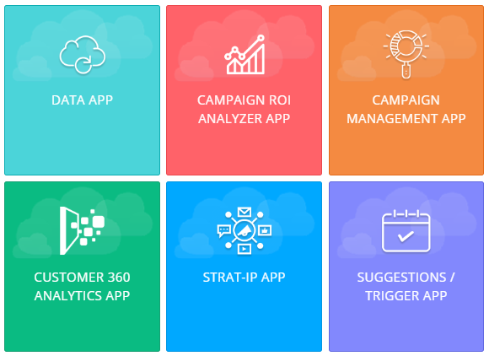
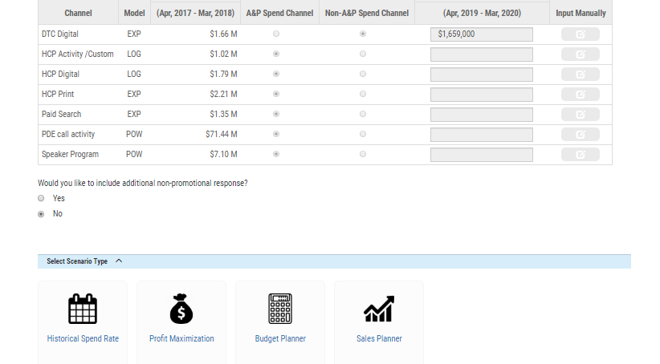
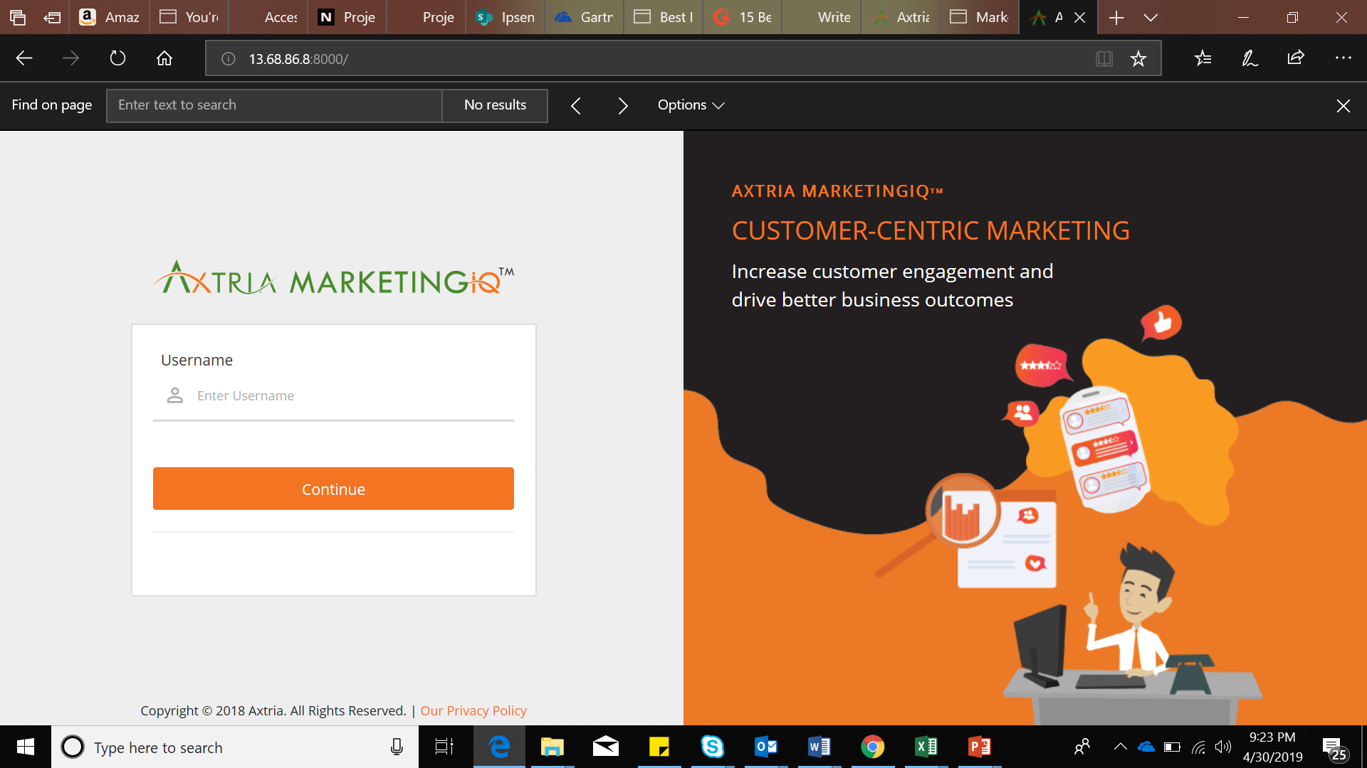
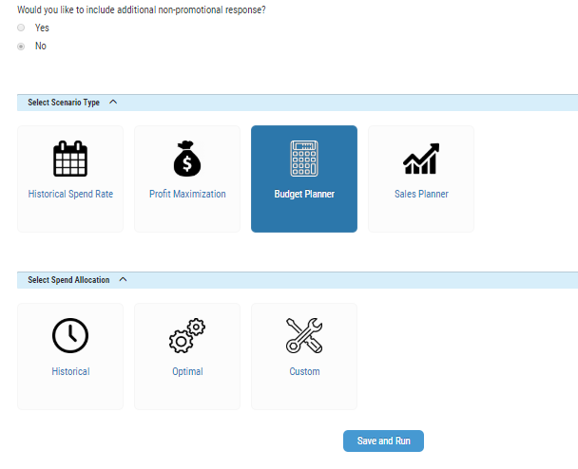
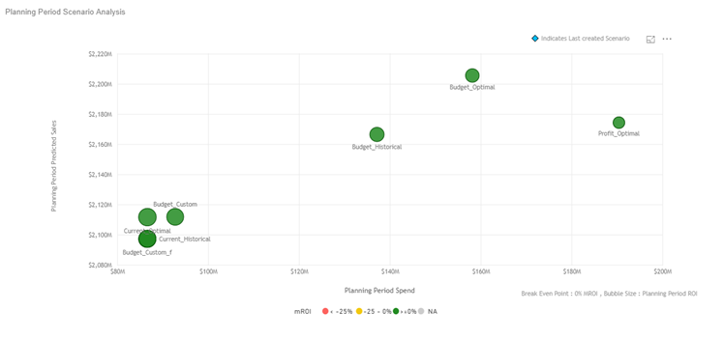

Axtria Marketing IQ™ Strat-IP Process
Business Process Overview
B
Planning Session Creation
Scenario Selection
C
A
App Login
Use Earlier
Planning Session
D
Model Selection
Scenario Visualization
Create New
Planning Session
E
Sales
Spend
Response File
INPUT FILES

Slide 6
Content
Business Process Overview
User Login and User Access
Open New Planning Session
Data Load
Create Scenario
Historical Spend Rate with Historical Allocation
Historical Spend Rate with Optimal Allocation
Profit Maximization
Budget Planner with Historical Allocation
Budget Planner with Optimal Allocation
Budget Planner with Custom Allocation
Sales Planner with Historical Allocation
Sales Planner with Optimal Allocation
Sales Planner with Custom Allocation
Save Planning Scenario
Scenario Visualization: Dollar Value Comparison
Scenario Visualization: Percentage Value Comparison & Extended Explanation
Scenario Visualization: Brand Manager & Deep Dive/Analyst Views
FAQs

Slide 7
User Login to Axtria Marketing IQ™ Strat-IP
Navigate to the login URL and enter credentials
INSTRUCTIONS
Open your web browser and navigate to the URL.
www.axtria-marketingiq.com
Enter your ID and password. Click on [Sign In] **
Also, for any help please use the following email address:
For help email:
- MIQSupport@axtria.com

Slide 8
User Access to Axtria Marketing IQ™ Strat-IP
Permission | Analyst | Planner | Reviewer
Overall Features
Create planning session | Y | N | N
Edit Planning session | Y | N | N
View planning session | Y | Y | Y
Create scenario | Y | Y | N
Edit scenario | Y | Y | N
View scenario | Y | Y | Y
Visualization | Y | Y | Y
Collaboration
Share planning session | Y | N | N
Collaborate scenario creation | Y | Y | N
Share scenario | Y | Y | N
Understanding of User Profiles:
Analyst: Can create Planning Sessions and perform advanced analytics functions
Scenario Planner: Can create new scenarios and modify shared scenarios
Reviewer: Can only review the previously generated and shared scenarios.

Slide 9
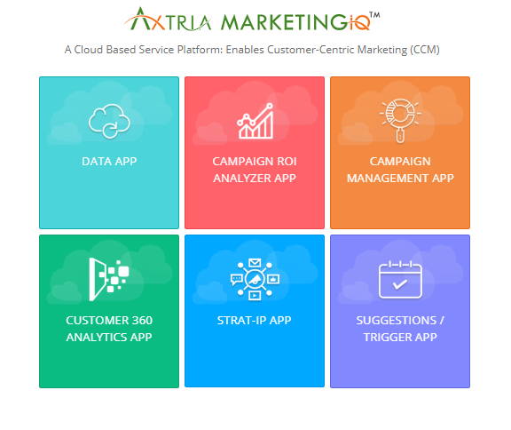
After Logging In, Select Strat-IP App
Select the Strat-IP App to launch the planning sessions view
INSTRUCTIONS
After logging in, select the Strat-IP App which will take the user to the home screen with Planning Scenario.
1

Slide 10
Content
Business Process Overview
User Login and User Access
Open New Planning Session
Data Load
Create Scenario
Historical Spend Rate with Historical Allocation
Historical Spend Rate with Optimal Allocation
Profit Maximization
Budget Planner with Historical Allocation
Budget Planner with Optimal Allocation
Budget Planner with Custom Allocation
Sales Planner with Historical Allocation
Sales Planner with Optimal Allocation
Sales Planner with Custom Allocation
Save Planning Scenario
Scenario Visualization: Dollar Value Comparison
Scenario Visualization: Percentage Value Comparison & Extended Explanation
Scenario Visualization: Brand Manager & Deep Dive/Analyst Views
FAQs

Slide 11
Create Planning Session
Strat-IP enables robust planning by allowing users to quickly and easily create planning sessions.
Upon login, users are able to easily set up planning sessions from the initial screens.
Planning sessions are the planning period or time horizon for spend and the associated change in forecast. Sessions are created by having and loading promotional response models for each channel (loaded as csv files), historical sales data (loaded as csv files), and historical spend data (loaded as csv).
The actual historical spend data may, for instance be until July 2018, however, the model is robust to enable the planning horizon to start in November 2018. Even if there is a gap in data – say August 2018 to October 2018, the model can bridge the gap….(known as the gap period)
For instance, the user is able to initially select the future time period and length to model out such as 6 months into the future. Once the selection for the future time period is made then this will be the time period modeled out into the future for any scenarios under this planning session. Thus, the shape of the response curve will remain the same throughout the planning session.

Slide 12
Activate Planning Session
There are two ways to activate a planning session-
1: Create a New Planning Session-
User can create New Planning Session if user want to work on new brand.
User can create New Planning Session if user wants to use new data files for the planning session.
User can create New Planning Session if user wants to plan for different planning period, as planning period is not editable.
2: Choose an Existing Planning Session-
Users can choose from the previous Planning Sessions created by them or shared with them by other users.
In existing planning Session values for A&P and Non-A&P channel will be persistent.
User can either use those values or can modify.
Best Practice for Planning Session:
Analysts familiar with the response curves and other data sets should create new planning session and share the planning session with Brand Team and other business users. These users will typically have Planner or Reviewer user types enabling them to view the planning sessions created by Analysts.
Using an existing planning session will enable the users to use data files, Planning Sessions configuration, and A&P and Non- A&P channels data inputted by the Analysts.

Slide 13
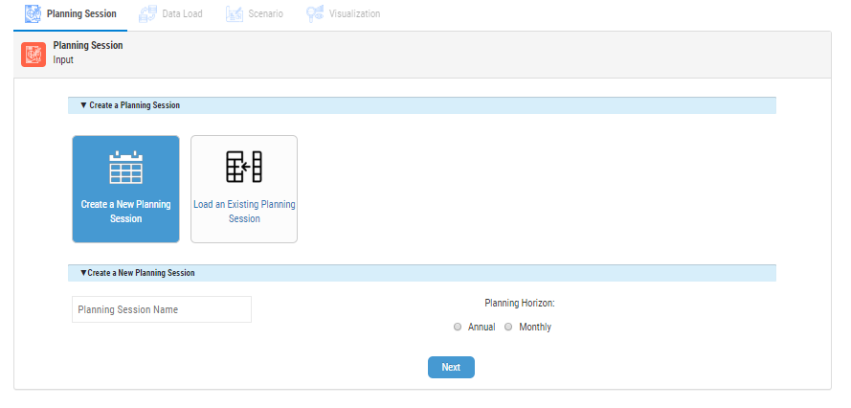
Open New Planning Session
Create a new scenario with new scenario name for a monthly/annual planning period
INSTRUCTIONS
User has two options for creating a planning session. To create a new planning session user selects “Create a new planning session” card
On clicking “Create a new planning session” card user has the option of creating a new Planning Session Name in the available boxes
User can also select the Planning Horizon by choosing Annual or Monthly option radio button. If an Annual option is chosen, user can select between Calendar Year or Fiscal Year
Click Next to Save the New Scenario and proceed
1
2
3
4

Slide 14
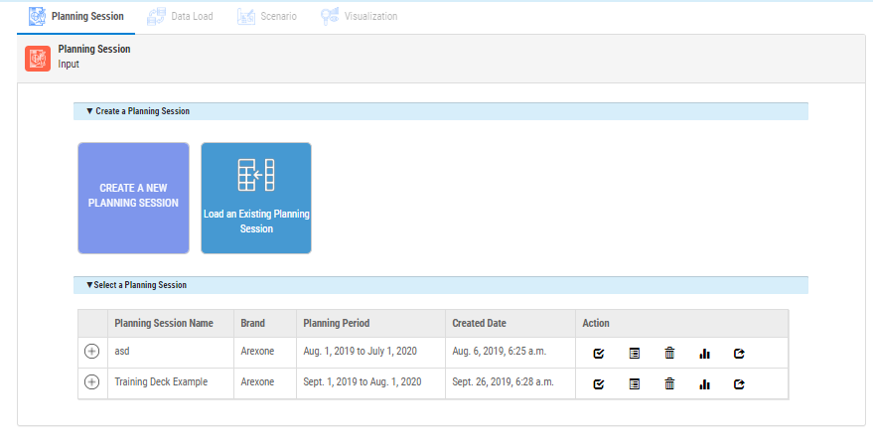
Open Previous Planning Session
Open a previously created scenario to execute specific available actions
INSTRUCTIONS
If user clicks on Load Existing Planning Session card while selecting a Planning Session, all previously created sessions will be displayed.
Each session will have information on related Brand and Planning Period.
Four Action items will be available to the User to choose:
Activate Planning Session
Review Planning Session
Delete Planning Session
View Scenario Visualization
Specific action will be executed when any of the four Action options are clicked.
1
2
3
4

Slide 15
Content
Business Process Overview
User Login and User Access
Open New Planning Session
Data Load
Create Scenario
Historical Spend Rate with Historical Allocation
Historical Spend Rate with Optimal Allocation
Profit Maximization
Budget Planner with Historical Allocation
Budget Planner with Optimal Allocation
Budget Planner with Custom Allocation
Sales Planner with Historical Allocation
Sales Planner with Optimal Allocation
Sales Planner with Custom Allocation
Save Planning Scenario
Scenario Visualization: Dollar Value Comparison
Scenario Visualization: Percentage Value Comparison & Extended Explanation
Scenario Visualization: Brand Manager & Deep Dive/Analyst Views
FAQs

Slide 16
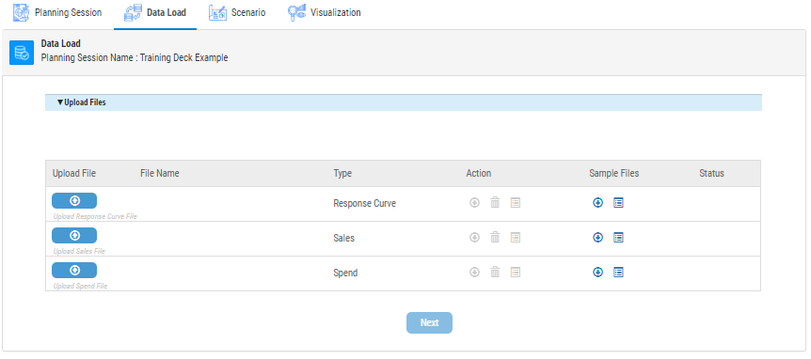
Data Load
Upload Sales, Spend and Response Curve data files through Upload Option
INSTRUCTIONS
Under File Name a list of files appear which are ready to be modeled. These files may be downloaded for review or deleted and re-uploaded, if need be. User has to upload these files in the order displayed. Data files are-
- Response Curve File : Consists of the response curve data for the historical channel expenditure for a specific brand
Sales File: Consists of the historical sales for the brand
Spend File: Consists of the historical spend for a s
Sample Files header allows the user to preview a sample of the required response curve file, the sales file and the spend file. The user us also allowed to download these files.
Click Next to Save the Scenario and proceed towards selection of the historical planning period. The planning period must be forward-looking and up to one year; otherwise, an error message will be triggered.
2
1
3

Slide 17
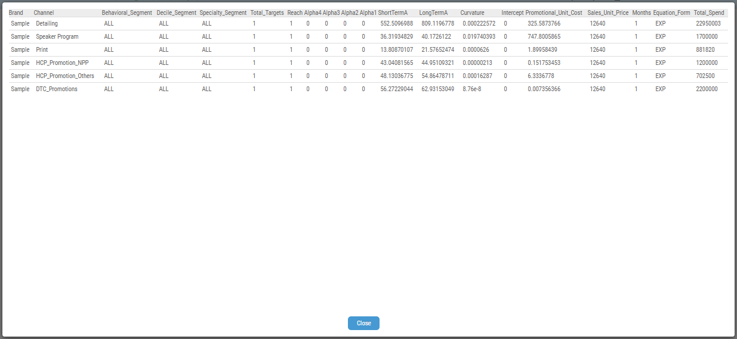
Data Load: Sample File Preview Example
PreSales, Spend and Response Curve data files through Upload Option
INSTRUCTIONS
The user can view the sample table, that the response curve, the spend and the sales files. The user can also choose to download these files. All columns of the files to be uploaded by the user must be arranged like in the sample files.

Slide 18
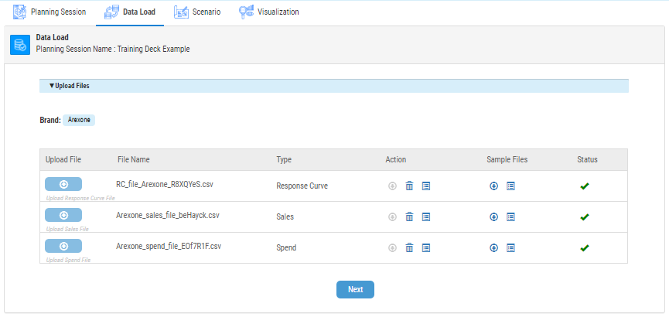
Data Load
Upload Sales, Spend and Response Curve data files through Upload Option
INSTRUCTIONS
Brand: This tag picks up all the brand for which data is uploaded across the three files.
File Name gives indication that the files are ready for use. Only one file for Spend, Sales, and Response Curve may be uploaded.
Status gives indication that the files are ready for use. Green arrows indicates that the files have passed validation checks in terms of having the appropriate variables needed for modeling.
Click Next to Save the Scenario and proceed
1
2
3
4

Slide 19
Content
Business Process Overview
User Login and User Access
Open New Planning Session
Data Load
Create Scenario
Historical Spend Rate with Historical Allocation
Historical Spend Rate with Optimal Allocation
Profit Maximization
Budget Planner with Historical Allocation
Budget Planner with Optimal Allocation
Budget Planner with Custom Allocation
Sales Planner with Historical Allocation
Sales Planner with Optimal Allocation
Sales Planner with Custom Allocation
Save Planning Scenario
Scenario Visualization: Dollar Value Comparison
Scenario Visualization: Percentage Value Comparison & Extended Explanation
Scenario Visualization: Brand Manager & Deep Dive/Analyst Views
FAQs

Slide 20
Create Session and Scenario Overview
Within the same planning session, the user is able to modify the historical time period to model on or base the forecasts on. For each planning session, the user is able to create and compare multiple scenarios. A scenario allows the user to specify the specific targets or goals the users has in terms of sales, for instance.
In total, there are four scenario types, each with up to a total of three spend type allocations.
Historical Spend Rate
Historical Spend Allocation
Optimal Spend Allocation
Profit Maximization
Optimal Spend Allocation
Budget Planner
Historical Spend Allocation
Optimal Spend Allocation
Custom Spend Allocation
Sales Planner
Historical Spend Allocation
Optimal Spend Allocation
Custom Spend Allocation

Slide 21
Create Session and Scenario Overview
The four scenario types are broken down as such for modeling purposes.
Historical Spend Rate – This scenario is used to model assuming a status quo that nothing changes from the historical time period to now to the future. In essence, this becomes your trend-line over time from which to forecast out….
Profit Maximization – This scenario generates the highest level of profit as spend levels/investments and sales are not constrained. Thus, spend levels are made at whatever level achieves the greatest profits.
Budget Planner – This scenario allows planning to a set budget target.
Sales Planner – This scenario allows to plan to a certain sales forecast in the planning horizon.

Slide 22
Create Session and Scenario Overview
The three spend allocation types are broken down as such for modeling purposes.
Historical – Spend allocation by channel stays consistent with historical spend patterns.
Optimal – For a given spend supplied by the user, the model allocates given spend optimally
Custom – For a given spend supplied by the user, the user has the opportunity to allocate given spend with a given spend rate allocation by channel.

Slide 23
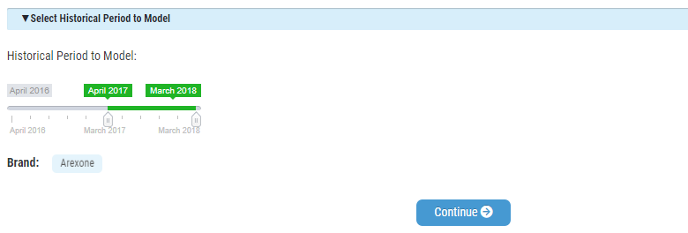
Create Scenario: Select Historical Period
Select historical period to model for Scenario Creation
INSTRUCTIONS
User is able to select the Historical Period to Model by slider.
Click Continue to select Non- A&P Spend Channels
1
2

Slide 24
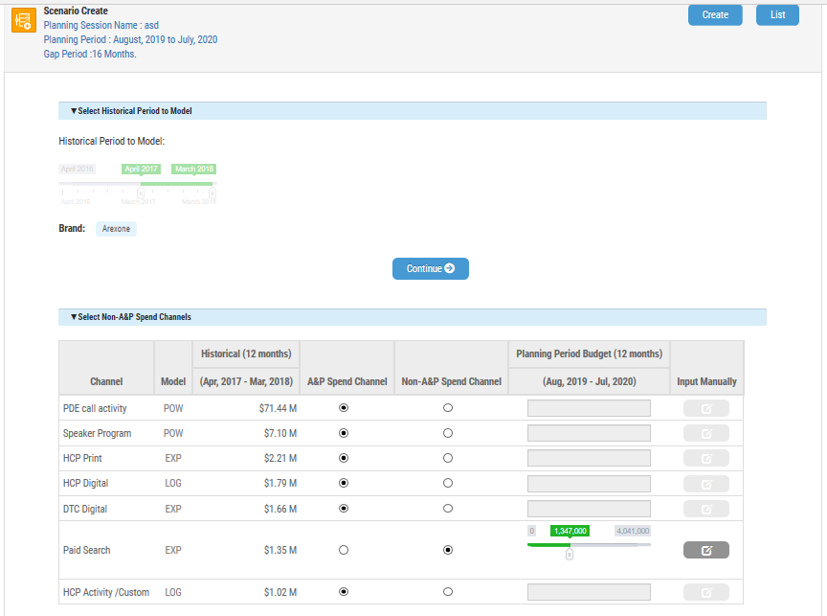
Create Scenario: Select Historical Period
Select historical period to model for Scenario Creation
INSTRUCTIONS
User is also able to select a historical period to review and view charts and graphics by using the slider.
Post selection of Historical Period user clicks Continue to view all Channels and their present A&P (Advertising and Promotion ) spend.
User can also Select Non-A&P Spend Channels and include additional non-promotional A&P spend category which we can review in the next slide.
1
2

Slide 25
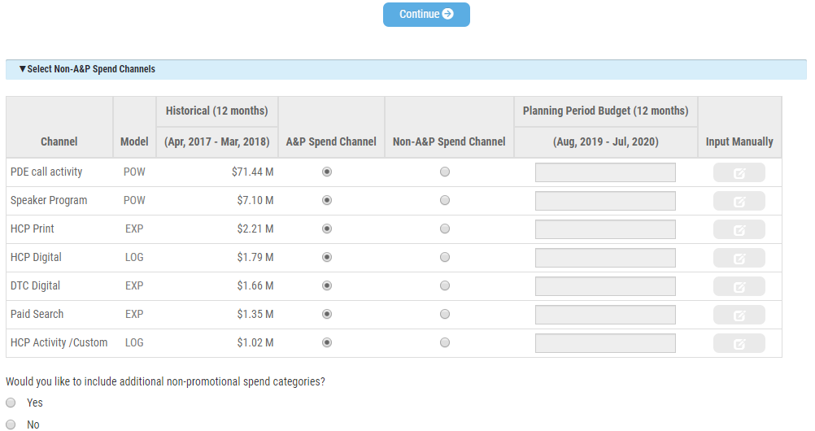
Create Scenario: A&P Spend Channels
A&P Spend Channels and include additional A&P Spend Category
INSTRUCTIONS
By default all the channels will be A&P.
User will be able to see all A&P channels in the constraint table.
For A&P channel user will not be able input any planning period budget.
1
2

Slide 26
A&P Spend Channels- Example
INSTRUCTIONS
Example in screenshot shows that the radio button selected in A&P Spend channel do not allow to enter any value in Planning Period Budget.

Slide 27
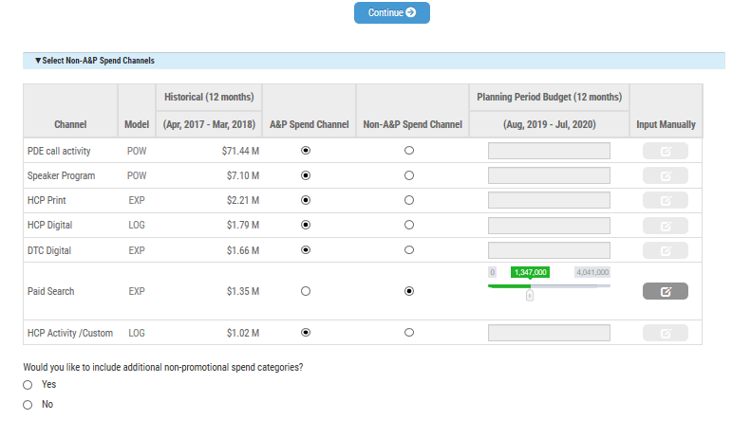
Create Scenario: Select Non A&P Spend Channels
Select Non A&P Spend Channels and include additional A&P Spend Category
INSTRUCTIONS
A&P (Advertising and Promotion): Those channels which have an impact on promotional activities and which will be optimized in Strat-IP for the chosen planning period.
Non-A&P (Advertising and Promotion): Those channels (and defined amount) which do not have an impact on promotional activities and where the specified amount does not need to be optimized for the planning period.
Users can Select any Non-A&P Spend Channel by clicking on the radio button for any chosen channel on the Non-A&P Spend Channel.
Upon clicking the radio button, user has the option to manually input the budget amount for the planning period using the slider, or clicking on the edit option next to the slider to enter a numeric value.
User also has the option of including additional non-promotional A&P spend category by answering the question for additional promotional with the Yes radio button.
Upon clicking the radio button user can manually input Spend Category Name and the budget amount for the planning period.
1
2
3
4

Slide 28
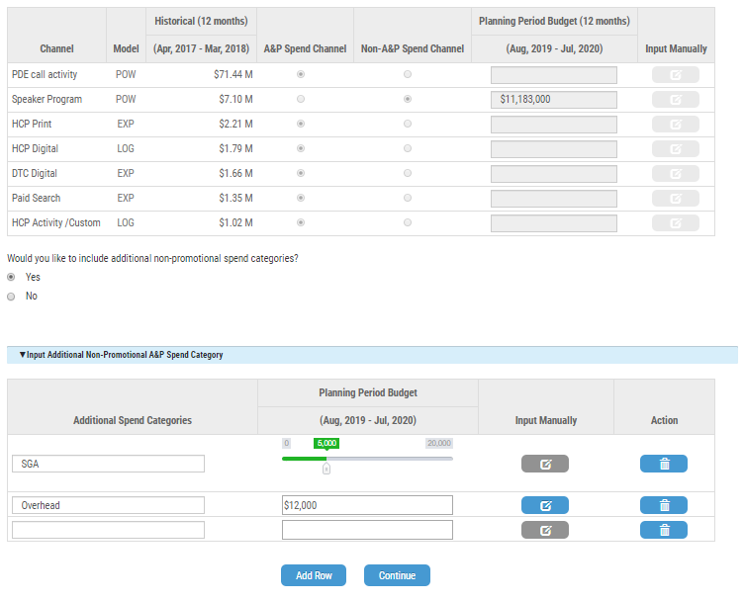
Add Non A&P Spend Channels: Example
INSTRUCTIONS
Users can add additional spend categories and their respective budgets using the slider option available, or click on the input button to include the
Upon clicking the input manually button, user has the option to manually input the budget amount for the planning period.
1
2

Slide 29
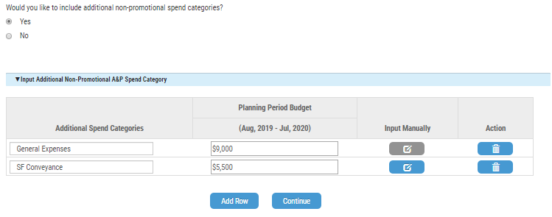
Add Additional Non-Promotional A&P Spend Category : Example
INSTRUCTIONS
User also has the option of including additional non-promotional A&P spend category by clicking a Yes radio button.
Upon clicking the radio button user can manually input Spend Category Name and the budget amount for the planning period.
User has the option to add new row by Add Row button.
1
2
3

Slide 30
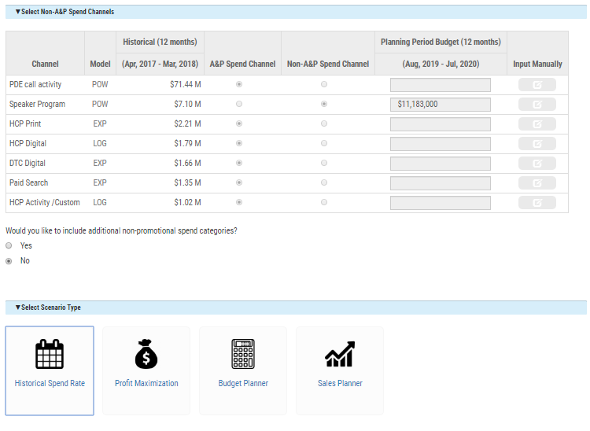
Create Scenario: Select Scenario Type
Create and decide on specific scenario and spend
INSTRUCTIONS
Select Scenario Type, select from one of the following four types depending on user goals.
Historical Spend Rate : Keep promotional investment rate same as historical. Model out the spend for future time period based on the historical rate.
Profit Maximization : Maximize profits using current investment rates. This is a theoretical maximization and is based on a calculated upper bound from the model.
Budget Planner : User selects the budget allocation. This is to plan and forecast to a fixed budget number. This can be customized based on specific budget amounts or can be optimized. Optimized budget plan will result in better results.
Sales Planner : User selects the sales amount user is targeting
1
2
3
4

Slide 31
Create Scenario: Select Spend Allocation
Create and decide on specific scenario and spend
INSTRUCTIONS
Select Spend Allocation and select from one of the following three types depending on user goals.
Historical: Keep promotional investment rate same as historical spend rate.
Optimal: Maximize profits using current investment rates. This results presents the highest, upper bound theoretical profit values.
Custom: User selects the budget allocation. This is customizable to amounts and percentages to the user’s preferences and needs.
1
2
3

Slide 32
Content
Business Process Overview
User Login and User Access
Open New Planning Session
Data Load
Create Scenario
Historical Spend Rate with Historical Allocation
Historical Spend Rate with Optimal Allocation
Profit Maximization
Budget Planner with Historical Allocation
Budget Planner with Optimal Allocation
Budget Planner with Custom Allocation
Sales Planner with Historical Allocation
Sales Planner with Optimal Allocation
Sales Planner with Custom Allocation
Save Planning Scenario
Scenario Visualization: Dollar Value Comparison
Scenario Visualization: Percentage Value Comparison & Extended Explanation
Scenario Visualization: Brand Manager & Deep Dive/Analyst Views
FAQs

Slide 33
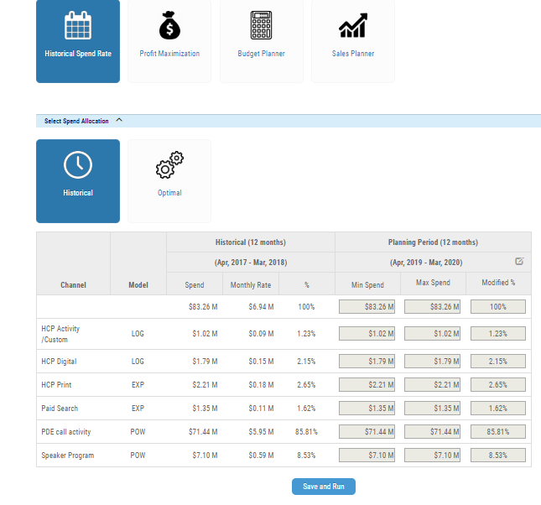
Use Case 1: Historical Spend Rate with Historical Allocation
INSTRUCTIONS
In order to run a scenario to using historical data, select both historical values. This is done to model out to future periods using the historical spend rate and historical spend allocation to view how past spend and spend rates will impact sales in the future. This is done by basing the Historical Spend on historical. First Select Historical Spend Rate.
Next, select Historical to base spend on the historical spend from prior periods. The Total Historical Spend is computed as per planning period i.e., Planning Period end date – start date
Since the Promotional spend is the same as historical spend, the % column is showing the total historical as well as channel spend.
Click to Save and Run the scenario.
1
2
3
4

Slide 34
Content
Business Process Overview
User Login and User Access
Open New Planning Session
Data Load
Create Scenario
Historical Spend Rate with Historical Allocation
Historical Spend Rate with Optimal Allocation
Profit Maximization
Budget Planner with Historical Allocation
Budget Planner with Optimal Allocation
Budget Planner with Custom Allocation
Sales Planner with Historical Allocation
Sales Planner with Optimal Allocation
Sales Planner with Custom Allocation
Save Planning Scenario
Scenario Visualization: Dollar Value Comparison
Scenario Visualization: Percentage Value Comparison & Extended Explanation
Scenario Visualization: Brand Manager & Deep Dive/Analyst Views
FAQs

Slide 35
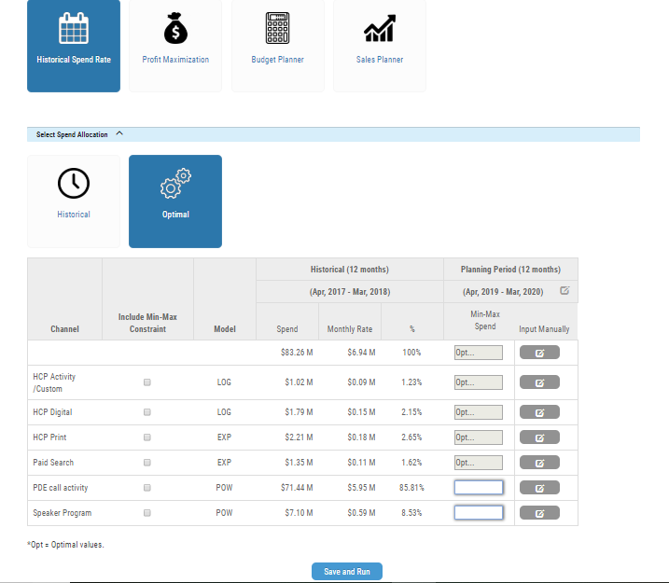
Use Case 2: Historical Spend Rate with Optimal Allocation
INSTRUCTIONS
In order to understand and determine how well current levels of historical spend rate will project out into the future based on an theoretical, optimal spend allocation determined by the model:
First Select Historical Spend Rate. The Total Historical Spend is computed as per planning period i.e., Planning Period end date – start date.
Next, select Optimal to enable the model to determine optimal spend levels across channels based on the Historical Spend rate and the historical spend as allocated.
The user also has the opportunity to enter Max Spend constraints, if so desired.
Click to Save and Run the scenario.
1
2
4
3

Slide 36
Content
Business Process Overview
User Login and User Access
Open New Planning Session
Data Load
Create Scenario
Historical Spend Rate with Historical Allocation
Historical Spend Rate with Optimal Allocation
Profit Maximization
Budget Planner with Historical Allocation
Budget Planner with Optimal Allocation
Budget Planner with Custom Allocation
Sales Planner with Historical Allocation
Sales Planner with Optimal Allocation
Sales Planner with Custom Allocation
Save Planning Scenario
Scenario Visualization: Dollar Value Comparison
Scenario Visualization: Percentage Value Comparison & Extended Explanation
Scenario Visualization: Brand Manager & Deep Dive/Analyst Views
FAQs

Slide 37
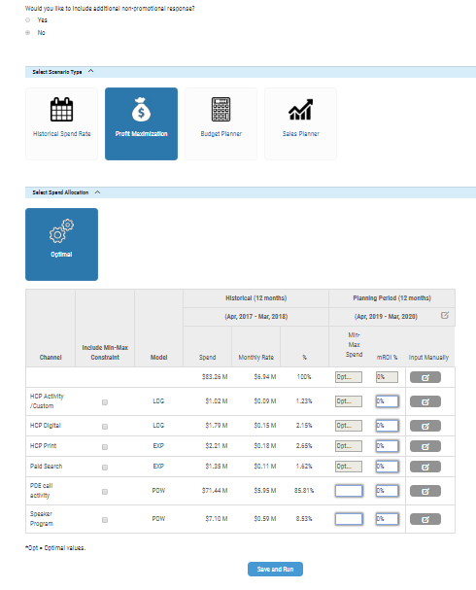
Use Case 3: Profit Maximization
INSTRUCTIONS
In order to run a scenario to maximize profits based on a model determined, theoretical upper bound. This provides an assessment of what maximum profits would occur in an ideal, optimal, theoretical situation: Select Profit Maximization. No other Spend Allocation options will be allowed. The model will allocate historical spend optimally in order to maximize profits.
The Total Historical Spend is computed as per planning period i.e., Planning Period end date – start date
The user also has the option to allocate Max Spend and mROI% targets as constraints in the table prior to running.
Click to Save and Run the scenario.
1
2
4
3

Slide 38
Content
Business Process Overview
User Login and User Access
Open New Planning Session
Data Load
Create Scenario
Historical Spend Rate with Historical Allocation
Historical Spend Rate with Optimal Allocation
Profit Maximization
Budget Planner with Historical Allocation
Budget Planner with Optimal Allocation
Budget Planner with Custom Allocation
Sales Planner with Historical Allocation
Sales Planner with Optimal Allocation
Sales Planner with Custom Allocation
Save Planning Scenario
Scenario Visualization: Dollar Value Comparison
Scenario Visualization: Percentage Value Comparison & Extended Explanation
Scenario Visualization: Brand Manager & Deep Dive/Analyst Views
FAQs

Slide 39
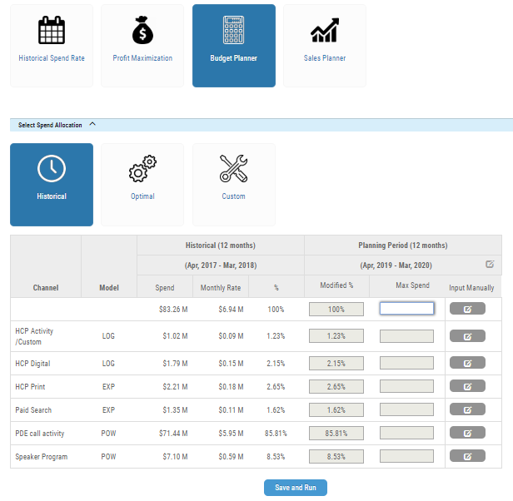
Use Case 4: Budget Planner with Historical Allocation
INSTRUCTIONS
In order to run a scenario to plan and model spend based on a set fixed, budget amount in order to determine how this will impact sales based on the historical spend allocation. Select Budget Planner.
Next, select the Historical tab. The model will allocate the updated budget based on historical spend.
Next, enter the budget amount as the Maximum Spend.
Click to Save and Run the scenario.
1
2
3
4

Slide 40
Content
Business Process Overview
User Login and User Access
Open New Planning Session
Data Load
Create Scenario
Historical Spend Rate with Historical Allocation
Historical Spend Rate with Optimal Allocation
Profit Maximization
Budget Planner with Historical Allocation
Budget Planner with Optimal Allocation
Budget Planner with Custom Allocation
Sales Planner with Historical Allocation
Sales Planner with Optimal Allocation
Sales Planner with Custom Allocation
Save Planning Scenario
Scenario Visualization: Dollar Value Comparison
Scenario Visualization: Percentage Value Comparison & Extended Explanation
Scenario Visualization: Brand Manager & Deep Dive/Analyst Views
FAQs

Slide 41
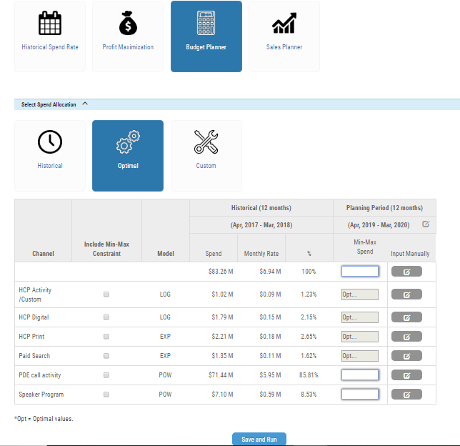
Use Case 5: Budget Planner with Optimal Allocation
INSTRUCTIONS
In order to run a scenario to plan and model spend based on a set fixed, budget amount seeking a more optimally/enhanced allocation and sales based on the model selections to improve sales, Select Budget Planner.
Next, select the Optimal tab. The model will allocate the updated budget based on historical spend.
Next, enter the budget amount as the Maximum Spend.
Click to Save and Run the scenario.
1
2
3
4

Slide 42
Content
Business Process Overview
User Login and User Access
Open New Planning Session
Data Load
Create Scenario
Historical Spend Rate with Historical Allocation
Historical Spend Rate with Optimal Allocation
Profit Maximization
Budget Planner with Historical Allocation
Budget Planner with Optimal Allocation
Budget Planner with Custom Allocation
Sales Planner with Historical Allocation
Sales Planner with Optimal Allocation
Sales Planner with Custom Allocation
Save Planning Scenario
Scenario Visualization: Dollar Value Comparison
Scenario Visualization: Percentage Value Comparison & Extended Explanation
Scenario Visualization: Brand Manager & Deep Dive/Analyst Views
FAQs

Slide 43
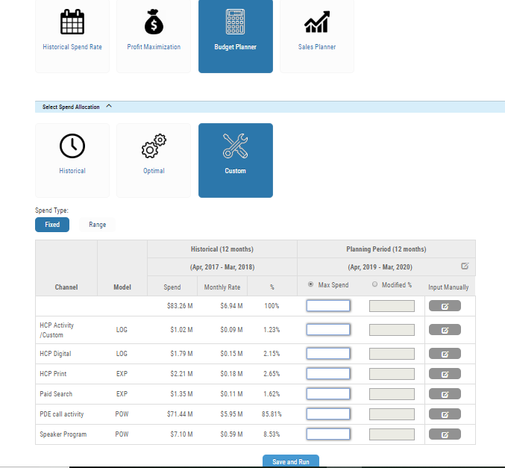
Use Case 6: Budget Planner with Custom Allocation - Fixed
INSTRUCTIONS
In order to run a scenario to plan and model spend based on a set fixed, budget amount seeking a more customized, Select Budget Planner.
Next, select the Custom tab. The model will allocate the updated budget based on customized spend.
Next, select the Fixed tab to fix the total amount at the historical spend but to enable channel by channel customized allocation.
The user has the ability to adjust the weighting and amounts. The individual channel budget amounts need to add up to 100% or the total amount entered. Otherwise, an error message will appear.
Click to Save and Run the scenario.
1
2
3
4
5

Slide 44
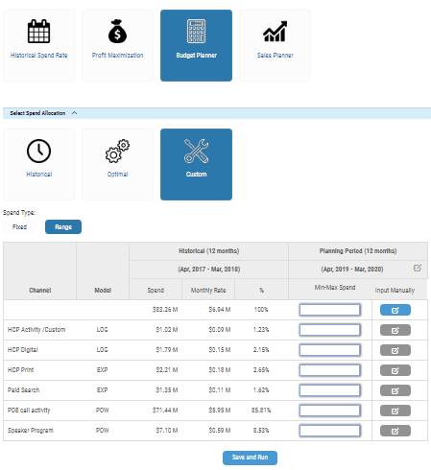
Use Case 6: Budget Planner with Custom Allocation - Range
INSTRUCTIONS
In order to run a scenario to plan and model spend based on a custom allocation. Select Budget Planner.
Next, select the Custom tab. The model will allocate the updated budget based on customized spend.
Next, select the Range tab to enable a range from Min Spend to Max Spend that is customizable to the user’s total budget.
The user has the ability to adjust the Min Spend and Max Spend. The individual channel budget amounts may be varied to any customizable budgetary amount.
Click to Save and Run the scenario.
1
2
3
4
5

Slide 45
Content
Business Process Overview
User Login and User Access
Open New Planning Session
Data Load
Create Scenario
Historical Spend Rate with Historical Allocation
Historical Spend Rate with Optimal Allocation
Profit Maximization
Budget Planner with Historical Allocation
Budget Planner with Optimal Allocation
Budget Planner with Custom Allocation
Sales Planner with Historical Allocation
Sales Planner with Optimal Allocation
Sales Planner with Custom Allocation
Save Planning Scenario
Scenario Visualization: Dollar Value Comparison
Scenario Visualization: Percentage Value Comparison & Extended Explanation
Scenario Visualization: Brand Manager & Deep Dive/Analyst Views
FAQs

Slide 46
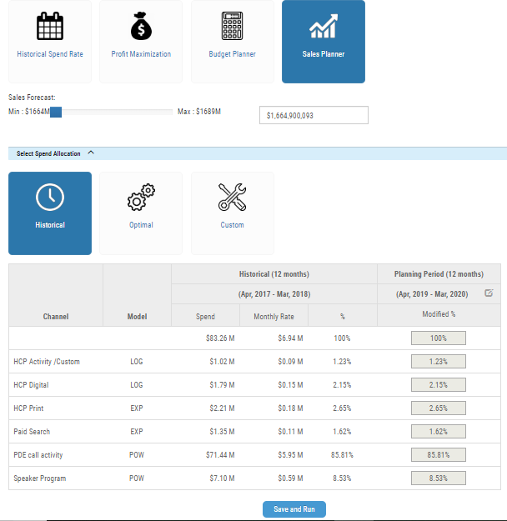
Use Case 7: Sales Planner with Historical Allocation
INSTRUCTIONS
To meet specific sales targets or forecasts, and to enable greater planning towards those forecasts and targets, Sales Planner enables planning using established spend allocation, allocation that is optimized or customized to give the user the utmost ability to model out with a greater degree of confidence the better means to meet goals.
In order to run a scenario to plan and model spend based on hitting specific sales forecast/targets. Select Sales Planner.
Next, select the Historical tab. The model will allocate the spend based on historical spend. As shown in the table, the total spend and channel spend represents the historical spend in the planning period.
Next, use the slider to the appropriate sales forecast target. The number selected by the slider will appear to the right in the box. The Min and Max values shown in the slider are calculated from previous sales history.
Click to Save and Run the scenario.
1
3
2
4

Slide 47
Content
Business Process Overview
User Login and User Access
Open New Planning Session
Data Load
Create Scenario
Historical Spend Rate with Historical Allocation
Historical Spend Rate with Optimal Allocation
Profit Maximization
Budget Planner with Historical Allocation
Budget Planner with Optimal Allocation
Budget Planner with Custom Allocation
Sales Planner with Historical Allocation
Sales Planner with Optimal Allocation
Sales Planner with Custom Allocation
Save Planning Scenario
Scenario Visualization: Dollar Value Comparison
Scenario Visualization: Percentage Value Comparison & Extended Explanation
Scenario Visualization: Brand Manager & Deep Dive/Analyst Views
FAQs

Slide 48
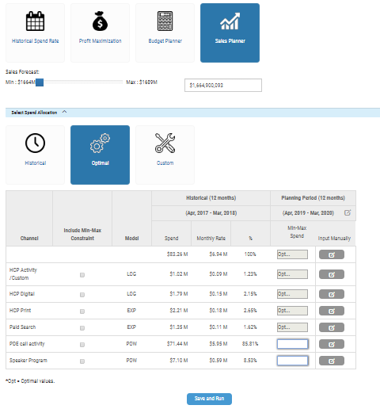
Use Case 8: Sales Planner with Optimal Allocation
INSTRUCTIONS
1
To meet specific sales targets or forecasts, and to enable greater planning towards those forecasts and targets, Sales Planner enables planning using established spend allocation, allocation that is optimized or customized to give the user the utmost ability to model out with a greater degree of confidence the better means to meet goals.
In order to run a scenario to plan and model spend based on sales forecast/targets. Select Sales Planner.
Next, select the Optimal tab. The model will optimally allocate the spend by channel to find the optimal level of spend to increase sales. There are no constraints placed on the spend in this scenario/use case.
Next, use the slider to the appropriate sales forecast target. The number selected by the slider will appear to the right in the box. The Min and Max values shown in the slider are calculated from previous sales history.
Click to Save and Run the scenario.
3
2
4

Slide 49
Content
Business Process Overview
User Login and User Access
Open New Planning Session
Data Load
Create Scenario
Historical Spend Rate with Historical Allocation
Historical Spend Rate with Optimal Allocation
Profit Maximization
Budget Planner with Historical Allocation
Budget Planner with Optimal Allocation
Budget Planner with Custom Allocation
Sales Planner with Historical Allocation
Sales Planner with Optimal Allocation
Sales Planner with Custom Allocation
Save Planning Scenario
Scenario Visualization: Dollar Value Comparison
Scenario Visualization: Percentage Value Comparison & Extended Explanation
Scenario Visualization: Brand Manager & Deep Dive/Analyst Views
FAQs

Slide 50
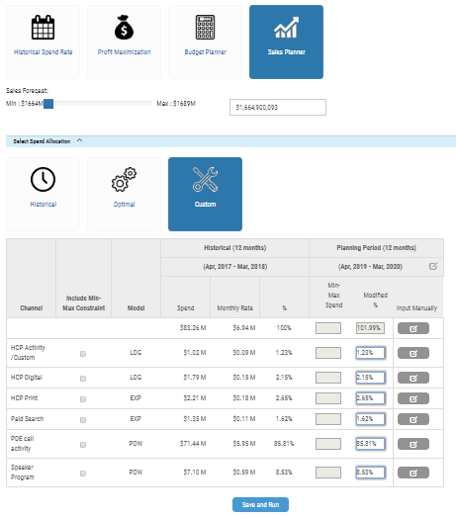
Use Case 9: Sales Planner with Custom Allocation
INSTRUCTIONS
To meet specific sales targets or forecasts, and to enable greater planning towards those forecasts and targets, Sales Planner enables planning using established spend allocation, allocation that is optimized or customized to give the user the utmost ability to model out with a greater degree of confidence the better means to meet goals.
In order to run a scenario to plan and model spend based on sales forecast/targets. Select Sales Planner.
Next, select the Custom tab. The model will allocate the spend by channel based on user specified inputs across each channel.
Next, use the slider to the appropriate sales forecast target. The number selected by the slider will appear to the right in the box. The Min and Max values shown in the slider are calculated from previous sales history.
Then, select the channel level spend percentage values in the Modified column. The totals must still add to the total historical spend levels and to the 100% total value of the historical spend.
Click to Save and Run the scenario.
1
3
2
4
5

Slide 51
Content
Business Process Overview
User Login and User Access
Open New Planning Session
Data Load
Create Scenario
Historical Spend Rate with Historical Allocation
Historical Spend Rate with Optimal Allocation
Profit Maximization
Budget Planner with Historical Allocation
Budget Planner with Optimal Allocation
Budget Planner with Custom Allocation
Sales Planner with Historical Allocation
Sales Planner with Optimal Allocation
Sales Planner with Custom Allocation
Save Planning Scenario
Scenario Visualization: Dollar Value Comparison
Scenario Visualization: Percentage Value Comparison & Extended Explanation
Scenario Visualization: Brand Manager & Deep Dive/Analyst Views
FAQs

Slide 52
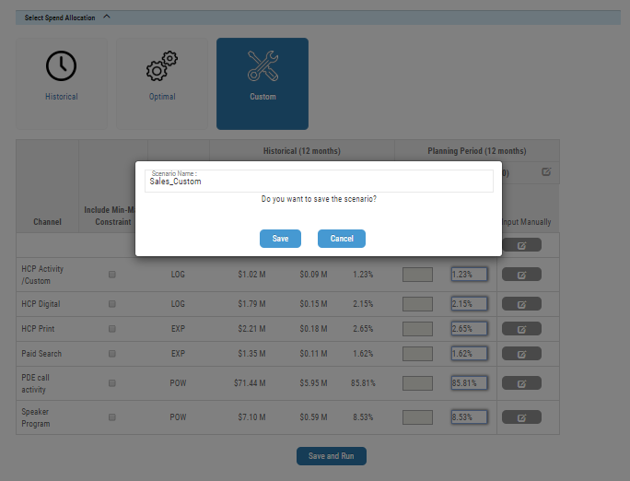
Save Planning Scenario:
INSTRUCTIONS
In order to save a scenario select Save and Run.
Next, a dialog box opens up to enter a Scenario Name. Scenario name is automatically generated by using Scenario Type + Allocation Type. The user also has the option to enter any name. Once the user enters the Scenario Name select the Save tab to save this particular scenario and its name.
2
1

Slide 53
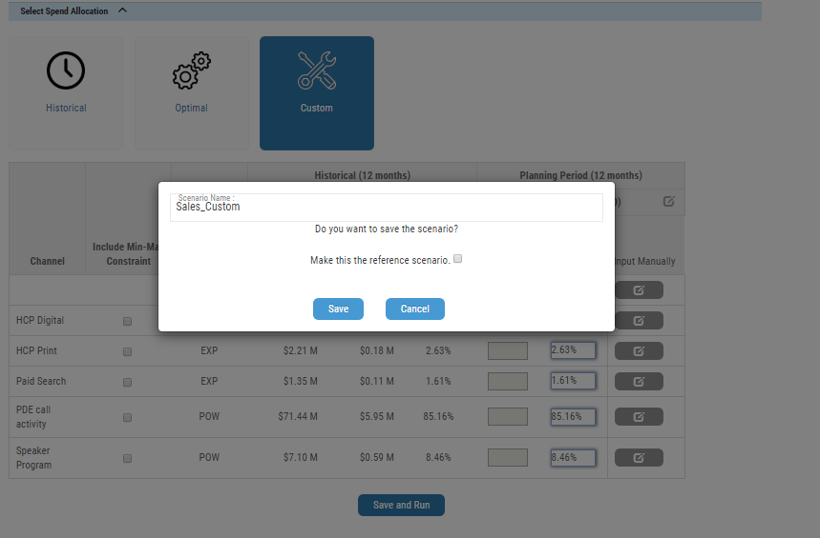
Save Planning Scenario: Reference Scenario Option
INSTRUCTIONS
In case a scenario already exist in a Planning Session and the user trying to create another scenario. Then the user would click on Save and Run. The user will get a dialogue box, which would have an additional feature of marking the scenario as a “Reference Scenario”. This feature enables the user to compare Results/ Visualizations of all the scenarios within the Planning Session based on this Reference Scenario.
Further in the application (In the List Scenario Functionality), the user has the ability to delete an existing Reference Scenario or make another scenario as Reference Scenario.
2
1
1

Slide 54
Content
Business Process Overview
User Login and User Access
Open New Planning Session
Data Load
Create Scenario
Historical Spend Rate with Historical Allocation
Historical Spend Rate with Optimal Allocation
Profit Maximization
Budget Planner with Historical Allocation
Budget Planner with Optimal Allocation
Budget Planner with Custom Allocation
Sales Planner with Historical Allocation
Sales Planner with Optimal Allocation
Sales Planner with Custom Allocation
Save Planning Scenario
Scenario Visualization: Scenario Comparison
Scenario Visualization: Percentage Value Comparison & Extended Explanation
Scenario Visualization: Brand Manager & Deep Dive/Analyst Views
FAQs

Slide 55
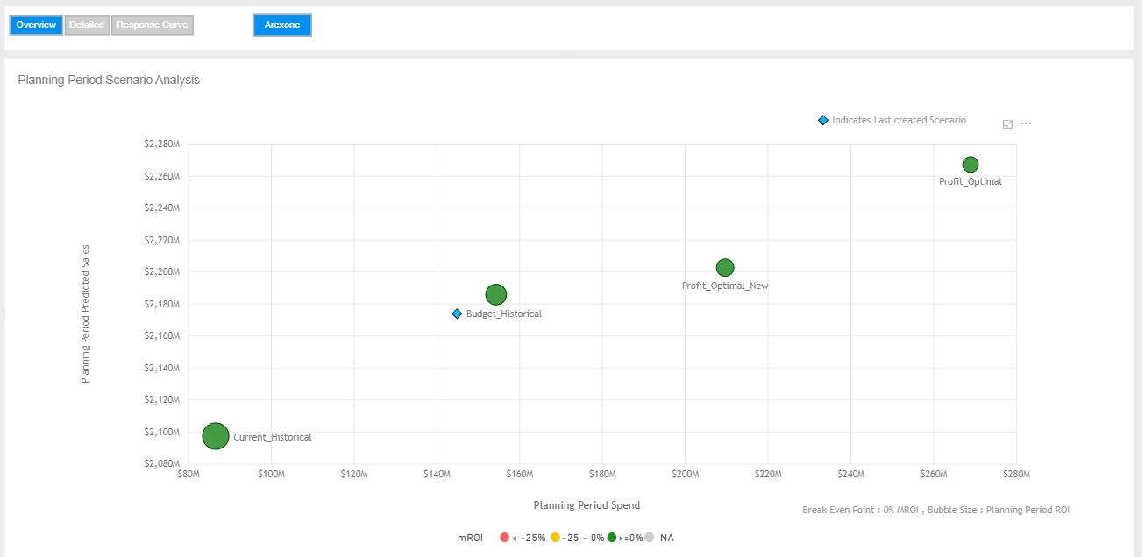
Scenario Visualization: Scenario Comparision
INSTRUCTIONS
User proceeds to click over Scenario visualization to go to see the scenario overview. User has the following options: A. Overview B. Detailed C. Response Curve
Overview -Scenario Comparison: User is shown a bubble chart comparative visualization of the scenarios. Dimensions compared are the Planning period predicted sales and the Planning period spend. The size of the bubble represents a third dimensionality of Return of Investment from the scenario. The colour of the bubble is representative of the marginal return of investment from the scenario Marginal Return of Investment. This represents the scenario comparison only for the planning period.
1
2

Slide 56
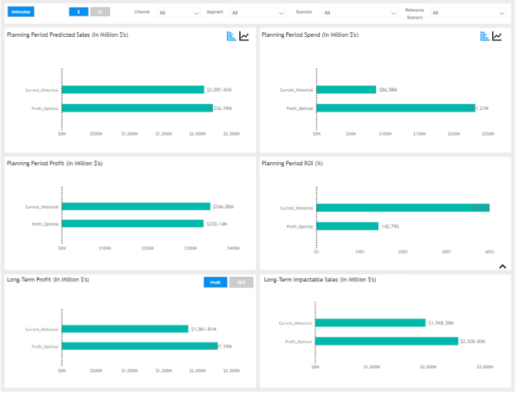
Scenario Visualization: Scenario Comparison-Detailed
INSTRUCTIONS
2
This Visualization tab helps us compare how spend, for instance, affects sales, profits, and long-term impactable sales. User can select four major scenario visualizations
Select the $ to view the values in dollar value terms. If the Reference Scenario is also selected, then the dollar terms will serve as the difference between the Scenario and the Reference Scenario.
Select the Scenario dropdown to view the List of scenarios available under a Planning session. Once scenarios are selected, the Output is shown for selected scenarios.
Select a Reference Scenario to use as a comparison against those available in the planning session.
Planning PerPlanning Period Predicted Sales shows Baseline + Impactable sales.
Planning Period Spend. This model predicts total spend on promotions across various channels.
Planning period Profits It predicts profit for the planning period.
Long-term Impactable Sales shows sales due to change in budget distribution across channels.
Planning Period ROI It shows ROI for the planning period.
Long Term Profit It shows long term profit.
1
3
4
5
6
8
9
7

Slide 57
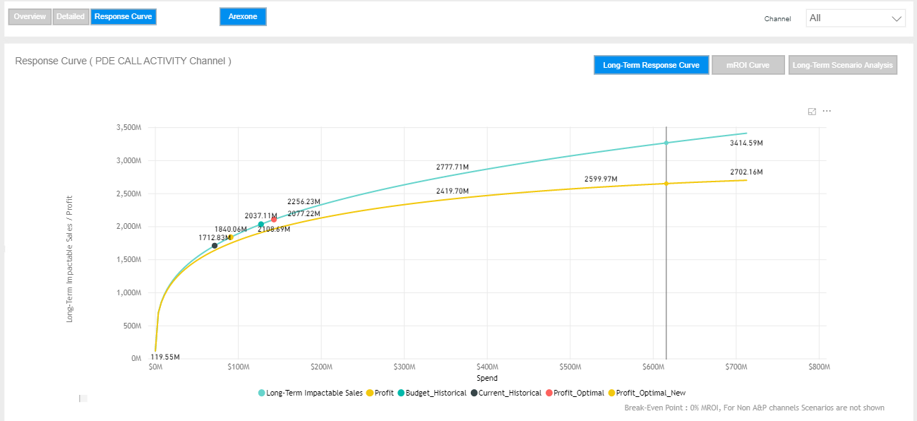
Scenario Visualization: Scenario Comparision – Response Curve
INSTRUCTIONS
2
The Response curve is accessible as part of the main menu, user can select Response Curve which will show a curve of the response curve across channel (s) as well as well as a comparison of the user create scenarios. In this case, the curve is showing the Longterm Impactable Sales versus the Spend. These curves with are colour coded to represent the sales curve and the profit curves. Each of the scenarios envisioned by the managers are represents as points along the sales curve.
Select from the Channel dropdown to select the channel for which the user wants to generate the response curves.
The user can toggle between the Long Term Impactable Sales based Response Curves, the marginal return of investment driven curves and the Long Term Scenario Analysis
1
3

Slide 58
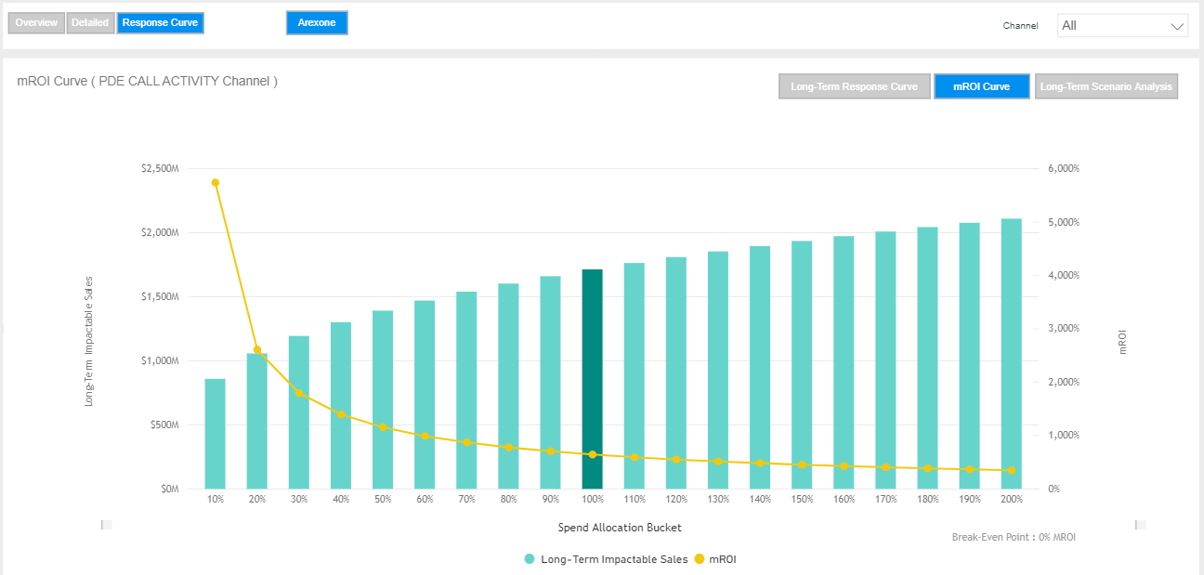
Scenario Visualization: Scenario Comparision – Response Curve
INSTRUCTIONS
1. After selecting the last is selected, user can select Response Curve which will show a curve of the response curve across channel (s) as well as well as a comparison of the user create scenarios. In this case, the curve is showing the Long-term Impactable Sales versus the Spend Allocation buckets. The curve depicted in yellow here points towards the behavior of the increasing spend buckets.
1

Slide 59
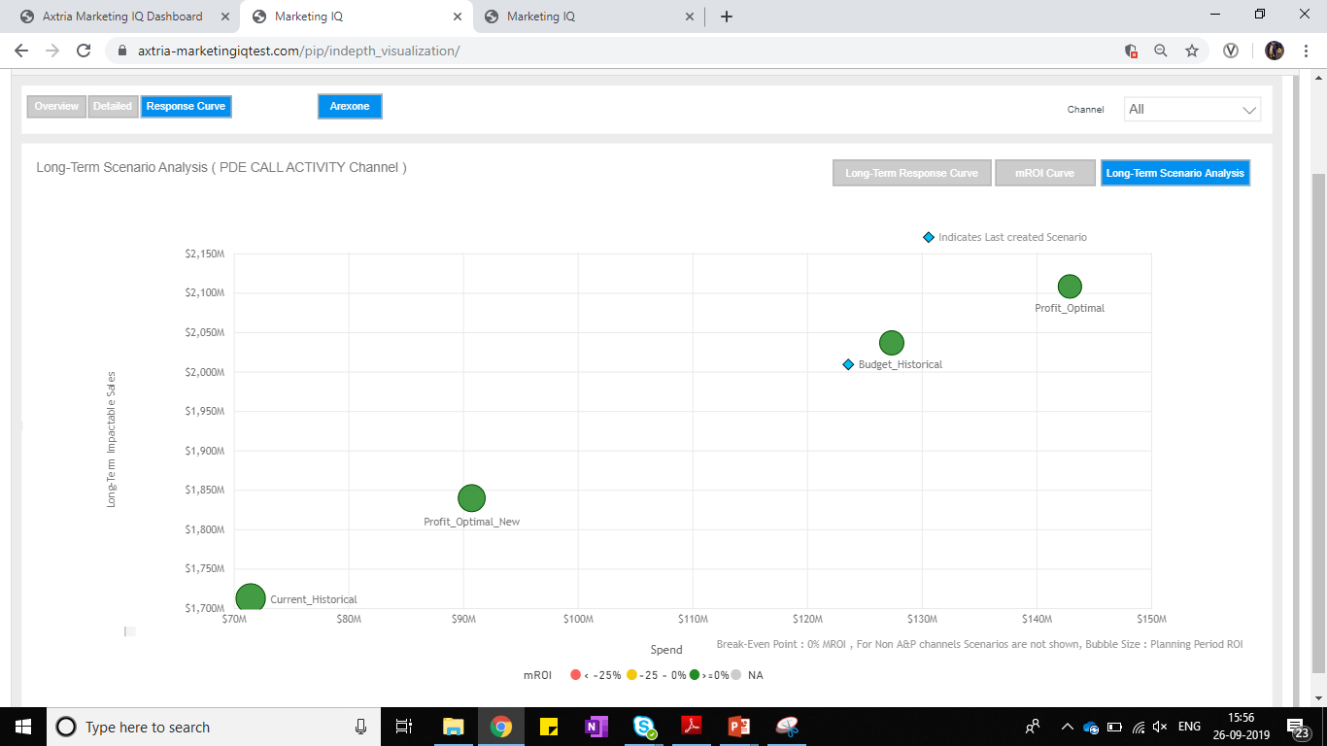
Scenario Visualization: Scenario Comparision – Long Term
INSTRUCTIONS
1. Long Tem Scenario Analysis - User is shown a bubble chart comparative visualization of the scenarios. Dimensions compared are the Planning period predicted sales and the Planning period spend. The size of the bubble represents a third dimensionality of Return of Investment from the scenario. The colour of the bubble is representative of the marginal return of investment from the scenario Marginal Return of Investment. This represents the scenario comparison only for the long term horizon.
1
1

Slide 60
Content
Business Process Overview
User Login and User Access
Open New Planning Session
Data Load
Create Scenario
Historical Spend Rate with Historical Allocation
Historical Spend Rate with Optimal Allocation
Profit Maximization
Budget Planner with Historical Allocation
Budget Planner with Optimal Allocation
Budget Planner with Custom Allocation
Sales Planner with Historical Allocation
Sales Planner with Optimal Allocation
Sales Planner with Custom Allocation
Save Planning Scenario
Scenario Visualization: Dollar Value Comparison
Scenario Visualization: Percentage Value Comparison & Extended Explanation
Scenario Visualization: Brand Manager & Deep Dive/Analyst Views
FAQs

Slide 61
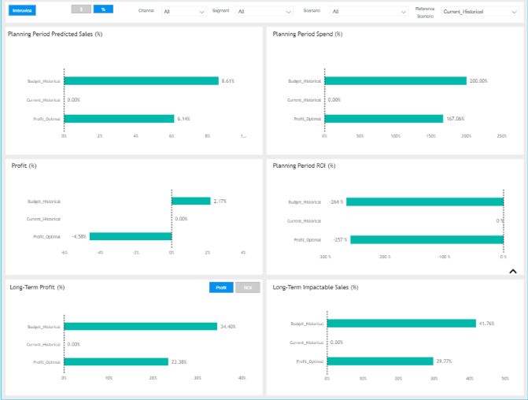
Scenario Visualization: Percentage Value Comparison
INSTRUCTIONS
The scenario visualizations present the four major comparisons across Predicted Period Sales, Planning Period Spend, Profit, and Long-Term Impactable Sales in Percentage Value Terms on similar lines the Dollar Value Comparison is visualized
Each of the screen splits can be used to view the same scenarios across the screen to compare how spend, for instance, affects sales, profits, and long-term impactable sales.

Slide 62
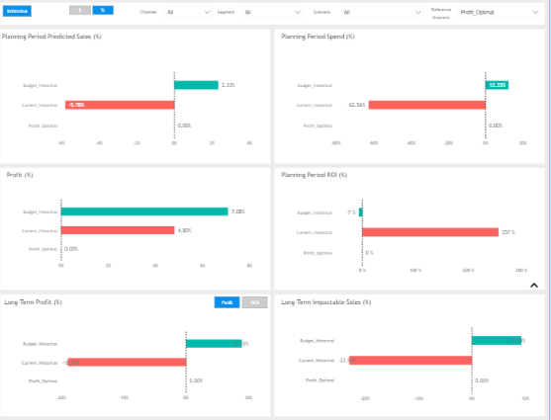
Scenario Visualization: Extended Explanation
INSTRUCTIONS
The scenario visualizations present 4 major comparisons across Planning Predicted Period Sales, Planning Period Spend, Profit, and Long-Term Impactable Sales. The four scenarios and their detailed definitions follow:
Planning Period Predicted Sales. This visualization shows the modeled predicted sales for the future time period/forecasting period in question. The planning period sales includes baselines sales, carryover, as well as brand equity, sales due to promos, and sales in the planning period. The visualization highlights the difference in each of the representative scenarios such as Budget Historical, Budget Optimal and Profit Maximization as compared to the Reference Scenario.
Planning Period Spend. This model predicts total spend on promotions across various channels. Likewise, this visualization compares for each of the three scenarios depicted and compares their spend compared to the Reference Scenario.
Profit. Depicts the Planning period Predicted Profit. This value may be compared across the various scenarios and as a comparison against the reference scenario.
Planning Period ROI It shows ROI for the planning period.
Long Term Profit It shows long term profit.
Long Term Impactable Sales: This is the predicted sales for the 24-month time period that begins after the planning period ends. It is the Sum of baseline sales + carryover + sales in the 24-month period predicted.
1
2
3
4
5
6

Slide 63
Content
Business Process Overview
User Login and User Access
Open New Planning Session
Data Load
Create Scenario
Historical Spend Rate with Historical Allocation
Historical Spend Rate with Optimal Allocation
Profit Maximization
Budget Planner with Historical Allocation
Budget Planner with Optimal Allocation
Budget Planner with Custom Allocation
Sales Planner with Historical Allocation
Sales Planner with Optimal Allocation
Sales Planner with Custom Allocation
Save Planning Scenario
Scenario Visualization: Scenario Comparison
Scenario Visualization: Percentage Value Comparison & Extended Explanation
Scenario Visualization: Brand Manager & Deep Dive/Analyst Views

Slide 64
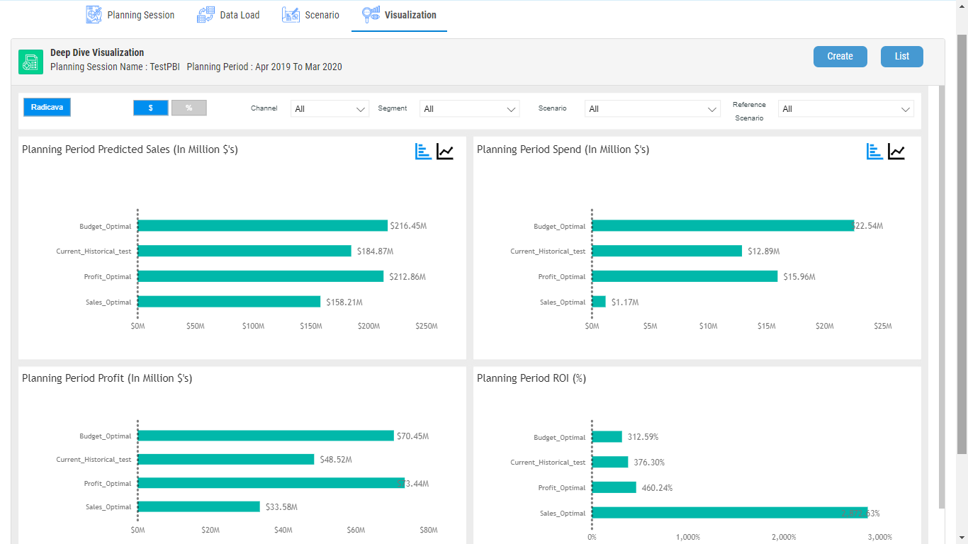
Scenario Visualization: Brand Manager Views
INSTRUCTIONS
1
Proceed to click over Scenario visualization to go to deep down view
Select the Scenario to select the Scenario(s) to view and select Reference Scenario to select the scenario(s) to compare against.
2

Slide 65
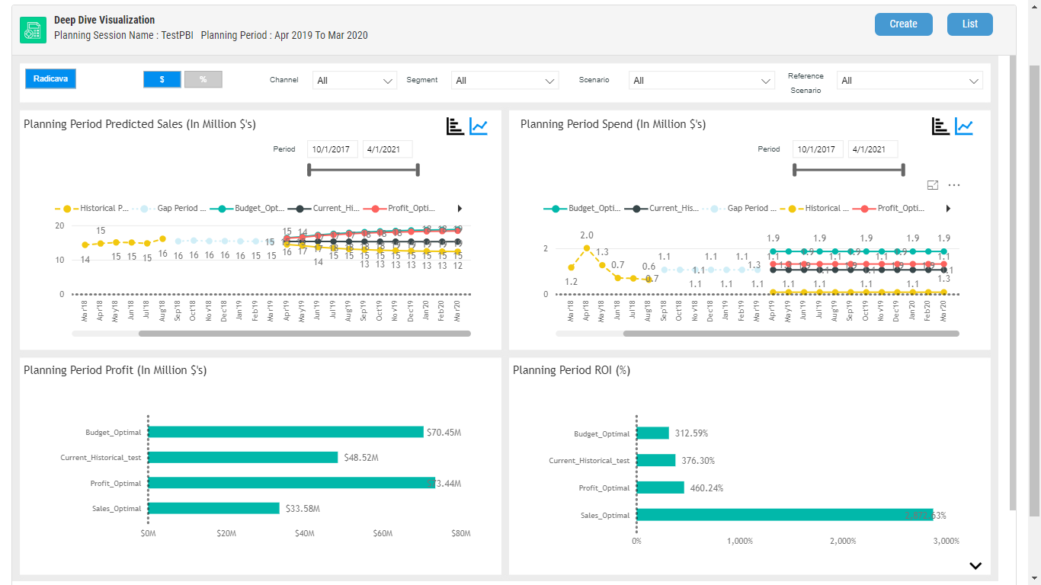
Scenario Visualization: Deep Dive/Analyst Views (screen 1)
INSTRUCTIONS
It shows comparative analysis for Historical sales and Predictive sales across scenarios.
It shows comparative analysis for Historical spent and Future spent across scenarios.
1
2

Slide 66
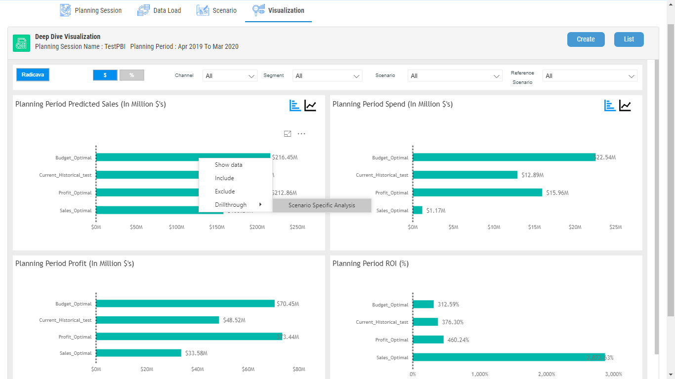
Scenario Visualization: Deep Dive/Analyst Views (screen 2)
INSTRUCTIONS
From the Brand Manager visualization, the user is then able to select and drilldown by scenario of interest by right clicking on the scenario to move to the Drill Through Visualizations.
This action will open the following screen shown in the next slide.

Slide 67
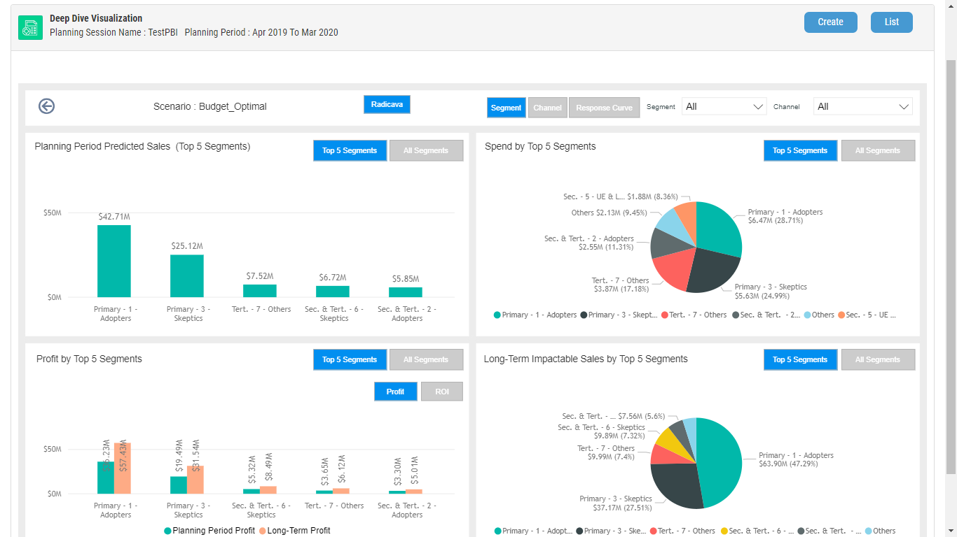
Scenario Visualization: Deep Dive/Analyst Views (screen 3)
INSTRUCTIONS
After the Drillthrough is selected, the adjacent screen opens which shows Sales, Spend, Profits, and Long Term Impactable Sales by Top 5 Segments. This is set as default. The user also has the option to select All Segments.

Slide 68
Content
Business Process Overview
User Login and User Access
Open New Planning Session
Data Load
Create Scenario
Historical Spend Rate with Historical Allocation
Historical Spend Rate with Optimal Allocation
Profit Maximization
Budget Planner with Historical Allocation
Budget Planner with Optimal Allocation
Budget Planner with Custom Allocation
Sales Planner with Historical Allocation
Sales Planner with Optimal Allocation
Sales Planner with Custom Allocation
Save Planning Scenario
Scenario Visualization: Scenario Comparison
Scenario Visualization: Percentage Value Comparison & Extended Explanation
Scenario Visualization: Brand Manager & Deep Dive/Analyst Views
FAQ

